Slide 1
Prepare, Prevent, Protect
Safety and Security Essentials

Slide 2



We Are SEC

Slide 3
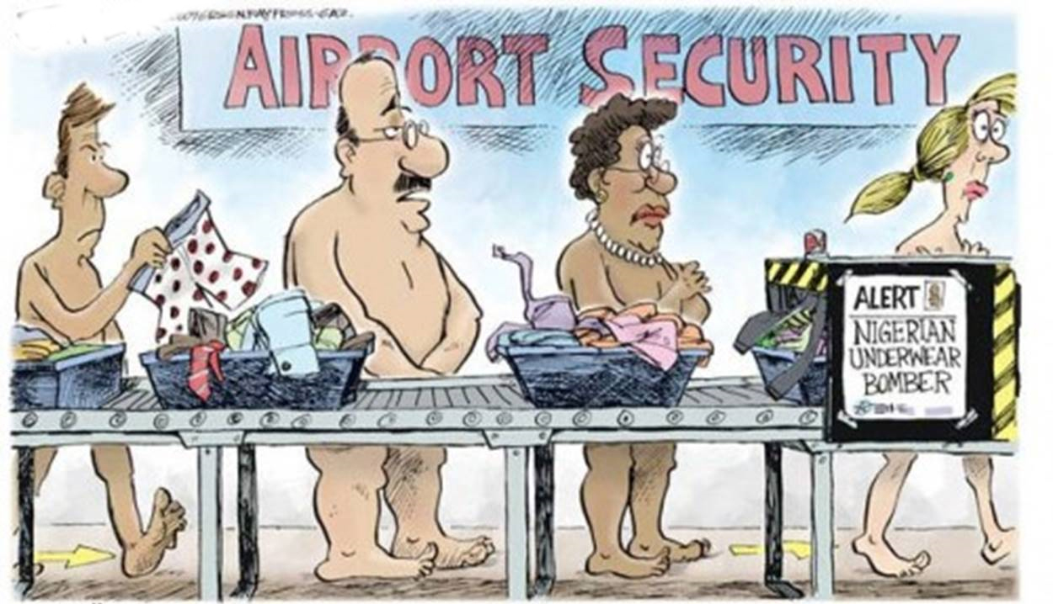
Barriers to Preparation
Cost
Culture
Aesthetics
Belief
Paralysis by Analysis
Notes:
Examination of the facility and surroundings.
How does our physical security affect how we can respond?
Book that nobody reads is not a plan.
Plan is a guide line
Like a football game plan or playbook. Practice is key “there are no time outs in emergencies”
Training and practice are the most important.

Slide 4
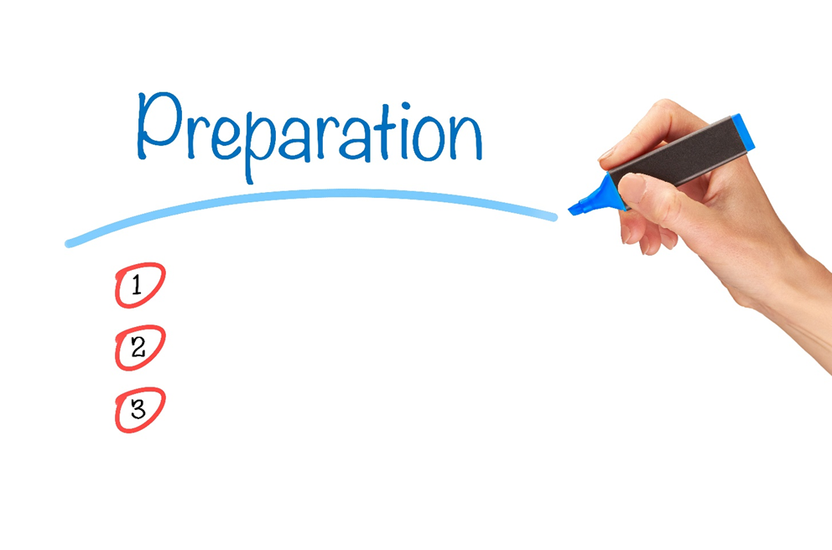
Three Phases
1. Pre-Incident Preparation
2. Incident Response
3. Post Incident Response and Communication
Notes:
Examination of the facility and surroundings.
How does our physical security affect how we can respond?
Book that nobody reads is not a plan.
Plan is a guide line
Like a football game plan or playbook. Practice is key “there are no time outs in emergencies”
Training and practice are the most important.

Slide 5



PRE-Incident Preparation
Training and Drills
Physical and Technical Security
Children
Staff
Process and Procedures

Slide 6





Communication
Environment
Training and Equipment
Exterior
Process and Procedure
Interior

Slide 7



Security Essentials
Secure entry with access control process…not a doorbell
Emergency Preparedness Plan – Primary Protocols
Critical Incident Response Training – MOST IMPORTANT LEAST LIKELY PERFORMED
Notes:
Examination of the facility and surroundings.
How does our physical security affect how we can respond?
Book that nobody reads is not a plan.
Plan is a guide line
Like a football game plan or playbook. Practice is key “there are no time outs in emergencies”
Training and practice are the most important.

Slide 8




Simplify response protocols
LOCKOUT
LOCKDOWN
EVACUATE
SHELTER
IN PLACE
Notes:
Basic response options
Most emergencies will fall into one of these 4 areas
ERT Team will lead the response
How will we communicate

Slide 9


LOCKOUT
THE MOST COMMONLY USED PROTOCOL
• ALERT! ALERT! ALERT!
• Ensure perimeter is secure
• Discontinue outside activities
• Notification/signage
• Be prepared to LockDown
Notes:
Relationships with law enforcement and other schools
Parents coming to get the kids
How will communication be handled? Do we call the parents

Slide 10

LOCKDOWN
IMMINENT THREAT RESPONSE
• ALERT! ALERT! ALERT!
• Secure yourself and students behind
a locked door when possible
• Cover & concealment
• Barricade/Tether
• Other considerations (lights, cell phones, etc.)
Notes:
Shades, what to do when someone is locked out, stuck in hallway, etc.
Two is one, one is none – Sign in and Tadpoles, Clothing
Motorcade routes

Slide 11

EVACUATE
THREAT TO FACILITY
• ALERT! ALERT! ALERT!
CONSIDERATIONS
• Evacuation routes
• Accountability
• Relocation sites and transportation
• Reunification
Notes:
Consider locations
Supplies
Emergency Contacts
Evacuation cribs and routes

Slide 12

SHELTER IN PLACE
NON HUMAN THREAT
• ALERT! ALERT! ALERT!
• Appropriate shelter locations based on threat
CONSIDERATIONS
• Sealing up rooms
• Supplies
• Utilities – electric, gas, water

Slide 13
Safety and Security Differentiators
Facility Assessment – Granular with actionable recommendations
Dual Authentication Entry – Something you are and something you know
All Security Features Backed by Process
Comprehensive Emergency Plan – Relocation Sites, Reunification etc.
Crisis Management Plan
Advanced Alert System
Regular and Documented Training Program – Onsite or Online
Glass Protection
Consultants on call
Notes:
Process each person goes thru in responding to danger.

Slide 14
Safety and Security Communication
MOST parents want to know even if they don’t ask.
Safety and Security should be presented in a positive way.
Safety and Security as a Differentiator

Slide 15
Questions and Answers
Jason.Russell@SecureEd.com
SecureEd.com

