Slide 1

Cultivating Young Scientists Through Culture and Family Engagement
Tara Henderson
Director of School and Community Programs
Victoria Roanhorse
School and Community Programs Manager

Slide 2
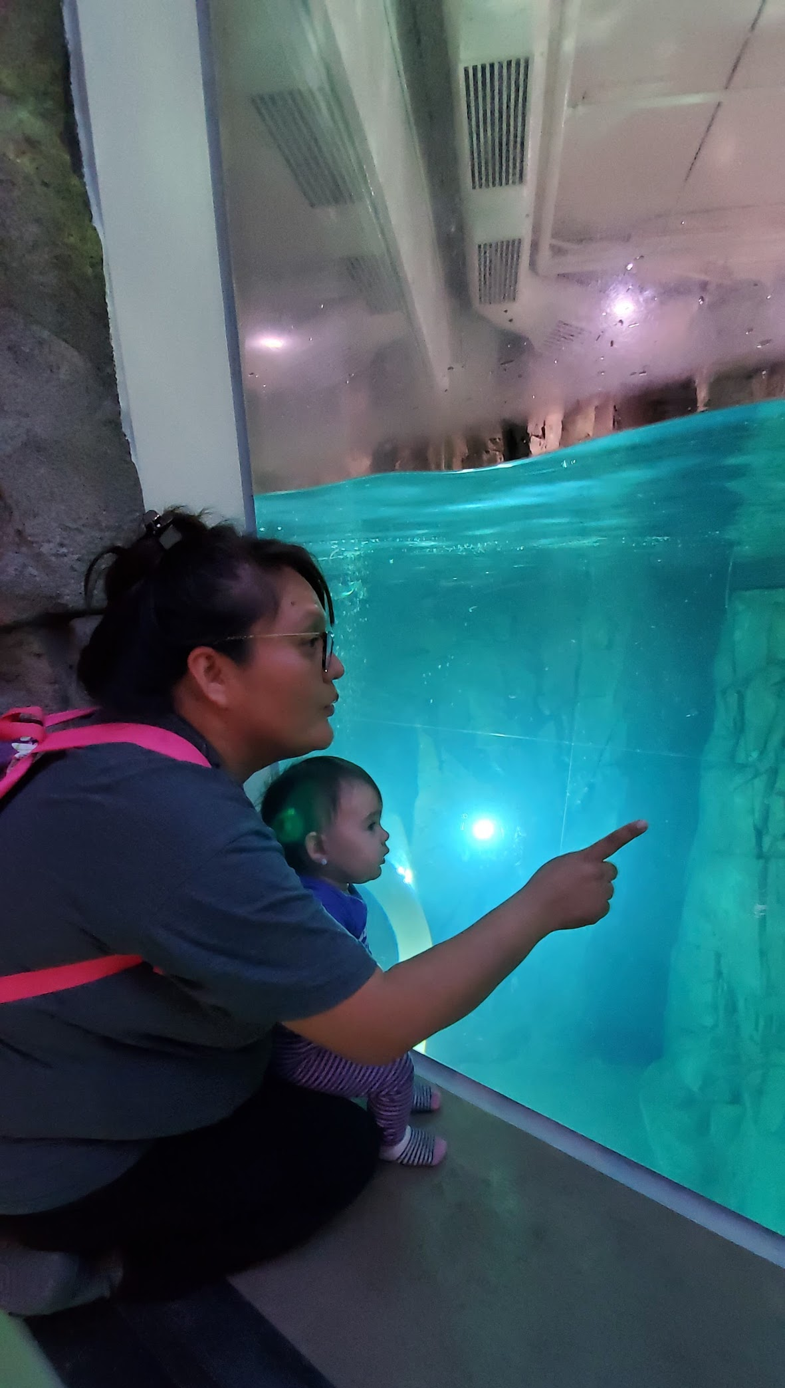
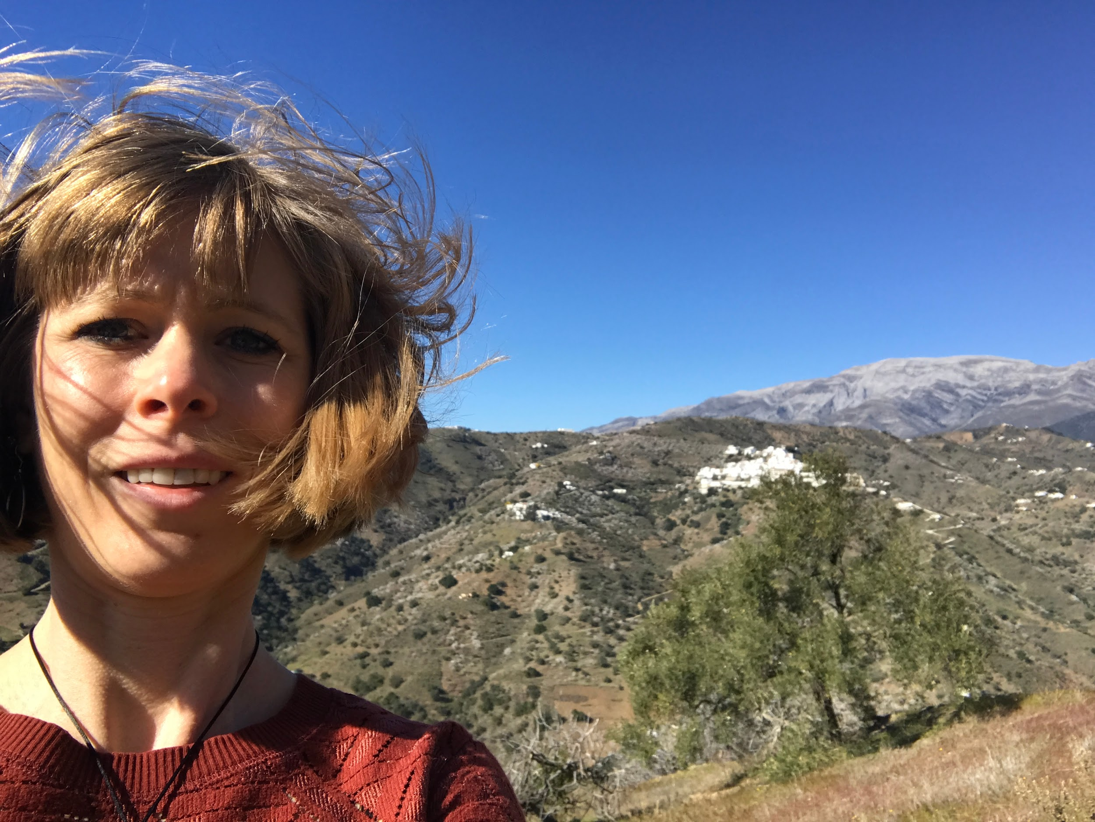
Who we are...
Victoria Roanhorse
Tara Henderson

Slide 3
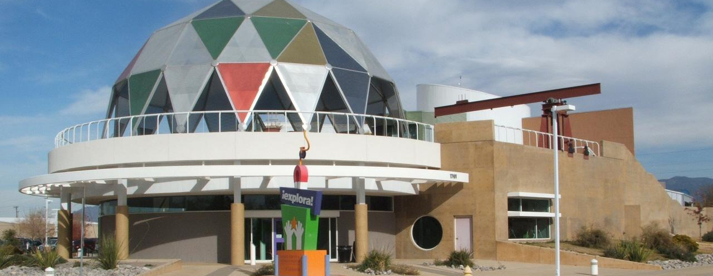
Explora
Albuquerque, NM

Slide 4
Mission:
Creating opportunities for inspirational discovery and the joy of lifelong learning through interactive experiences in science, technology, engineering, art, and math.

Slide 5

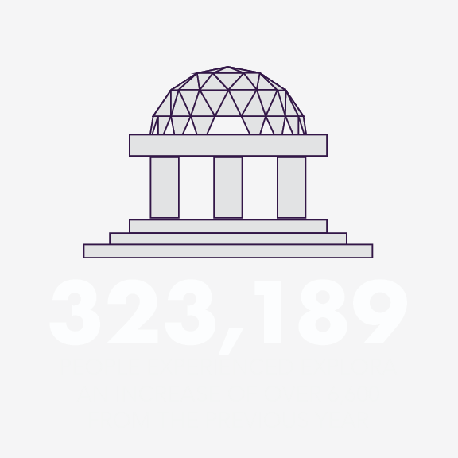
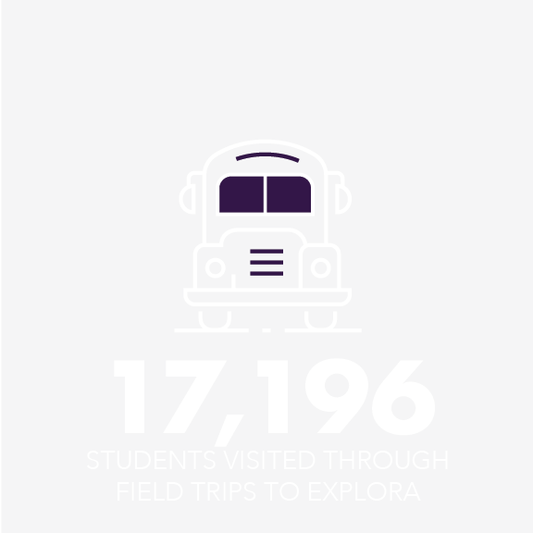
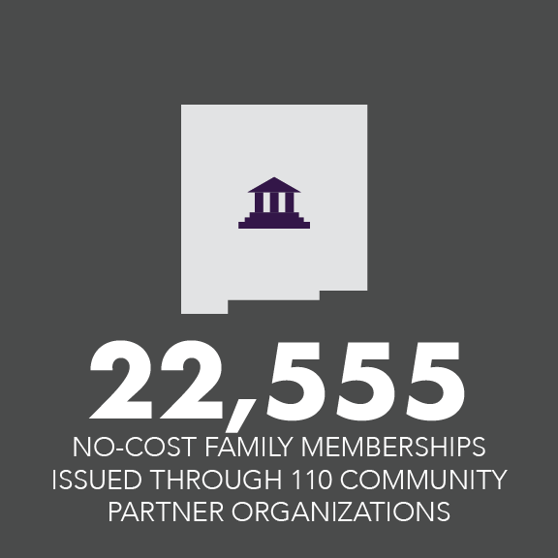
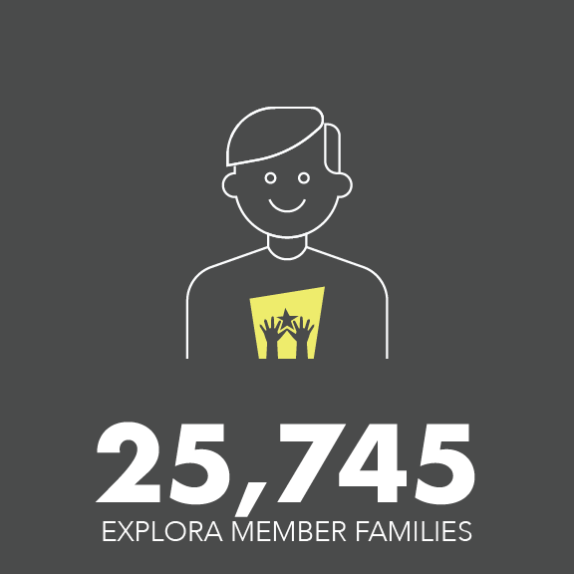
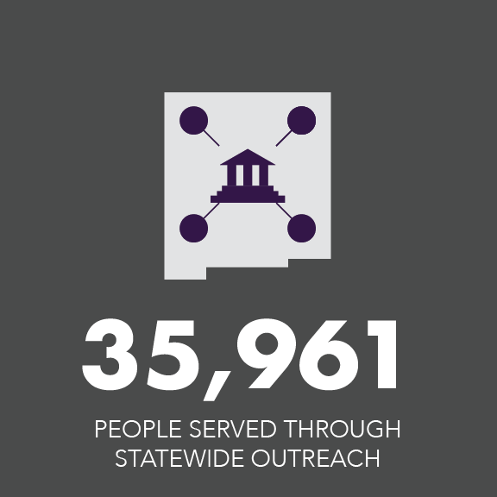
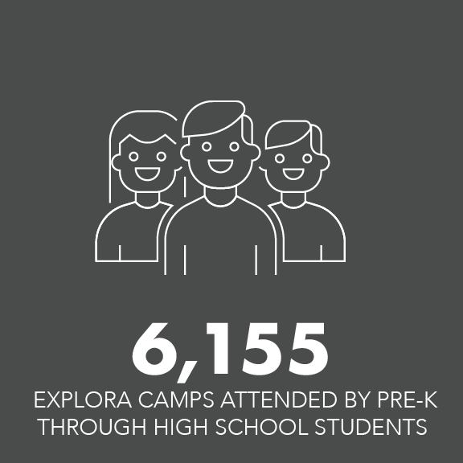
By the numbers
July 1, 2017 – June 30, 2018
5
Notes:
The number of people served through statewide outreach has steadily been increasing and may be on track to add 10-20 thousand during this current year.

Slide 6
Used a pattern to sew, crochet, or knit something | Has a family member that’s a scientist or engineer | Knows the names of 3 constellations | Has read a scientific journal article
Likes looking for shells at the beach | Fixed a bicycle or car | Has jumped started a vehicle | Has a garden or has grown fruits and/or vegetables
Enjoys building projects | Collected sand/dirt samples | Thinks science is cool! | Can explain the word “sublimation”
Went to the zoo as a child | Has baked a cake, bread, biscuits, tortillas, and/or pancakes | Drawn a picture of something they have seen | Taken care of an animal
Notes:
Looking at this grid of behaviors, tasks, challenges,
How many of these can you initial for yourself? What about people you know, how many could you get filled in?

Slide 7
Science Capital Bingo POLL 1

Slide 8
Science Capital Bingo POLL 2

Slide 9
IF...
...we build science capital and family science habitus with youth and their families...
We will enhance the participation of the youth in STEM leisure activities, increase their science self-efficacy and interest in STEM, and ultimately enhance STEM career aspirations.
Notes:
In order to alter the current patterns of STEM engagement, researchers of science capital assert that educators need to take a systems approach to the problem and provide youth with the full range of supports needed to alter their career trajectories. This support system includes the family (broadly defined), friends, a community of other families, resources, experiences, educators, and mentors.

Slide 10
Science Capital: the academic, social, and cultural aspects of a students’ life that may or may not encourage interest and participation in science.
Family Habitus for Science: science and engineering is “‘who we are,’ and ‘what we do,’ and what is ‘usual for us’” (Archer et al., 2012)
Notes:
This work is coming out of King’s College in the UK and is also work coming out of NC State University on this area of research.

Slide 11
Key Dimensions of Science Capital
Scientific Literacy:
A young person’s knowledge and understanding about science and how science works. This also includes their confidence in feeling that they know about science.
Source: https//www.stem.org.uk/sites/default/files/pages/downloads/Science-Capital-Made-Clear.pdf
Notes:
These dimensions are the aspects of science capital which are most closely related to post-high school participation and for fostering a sense that science is ‘for me”. That is, the more of the following that a young person has, the more likely they are to plan to continue with science in the future.

Slide 12
Key Dimensions of Science Capital
Science-related Attitudes, Values, and Dispositions:
This refers to the extent to which a young person sees science as relevant to everyday life (for instance, the view that science is ‘everywhere’).
Source: https//www.stem.org.uk/sites/default/files/pages/downloads/Science-Capital-Made-Clear.pdf
Notes:
These dimensions are the aspects of science capital which are most closely related to post-high school participation and for fostering a sense that science is ‘for me”. That is, the more of the following that a young person has, the more likely they are to plan to continue with science in the future.

Slide 13
Key Dimensions of Science Capital
Knowledge about the Transferability of Science:
Understanding the utility and broad application of science qualifications, knowledge, and skills used in science (e.g. that these can lead to a wide range of jobs beyond, not just in, science fields).
Source: https//www.stem.org.uk/sites/default/files/pages/downloads/Science-Capital-Made-Clear.pdf
Notes:
These dimensions are the aspects of science capital which are most closely related to post-high school participation and for fostering a sense that science is ‘for me”. That is, the more of the following that a young person has, the more likely they are to plan to continue with science in the future.

Slide 14
Key Dimensions of Science Capital
Science Media Consumption:
The extent to which a person, for example, watches science- related television, reads science-related books, magazines and engages with science-related internet content.
Source: https//www.stem.org.uk/sites/default/files/pages/downloads/Science-Capital-Made-Clear.pdf
Notes:
These dimensions are the aspects of science capital which are most closely related to post-high school participation and for fostering a sense that science is ‘for me”. That is, the more of the following that a young person has, the more likely they are to plan to continue with science in the future.

Slide 15
Key Dimensions of Science Capital
Participation in/out of Science Learning Contexts:
How often a young person participates in informal science learning contexts, such as science museums, science clubs, fairs, etc.
Source: https//www.stem.org.uk/sites/default/files/pages/downloads/Science-Capital-Made-Clear.pdf
Notes:
These dimensions are the aspects of science capital which are most closely related to post-high school participation and for fostering a sense that science is ‘for me”. That is, the more of the following that a young person has, the more likely they are to plan to continue with science in the future.

Slide 16
Key Dimensions of Science Capital
Family Science Skills, Knowledge, and Qualifications:
The extent to which a young person’s family have science-related skills, qualifications, jobs, and interests.
Source: https//www.stem.org.uk/sites/default/files/pages/downloads/Science-Capital-Made-Clear.pdf
Notes:
These dimensions are the aspects of science capital which are most closely related to post-high school participation and for fostering a sense that science is ‘for me”. That is, the more of the following that a young person has, the more likely they are to plan to continue with science in the future.

Slide 17
Key Dimensions of Science Capital
Knowing People in Science Related Roles:
The people a young person knows (in a meaningful way) in their family, friends, peer, and community circles who work in science-related roles.
Source: https//www.stem.org.uk/sites/default/files/pages/downloads/Science-Capital-Made-Clear.pdf
Notes:
These dimensions are the aspects of science capital which are most closely related to post-high school participation and for fostering a sense that science is ‘for me”. That is, the more of the following that a young person has, the more likely they are to plan to continue with science in the future.

Slide 18
Key Dimensions of Science Capital
Talking about Science in Everyday Life:
How often a young person talks about science out of school with key people in their lives (e.g. friends, siblings, parents, neighbors, community members) and the extent to which a young person is encouraged to continue with science by key people in their lives.
Source: https//www.stem.org.uk/sites/default/files/pages/downloads/Science-Capital-Made-Clear.pdf
Notes:
These dimensions are the aspects of science capital which are most closely related to post-high school participation and for fostering a sense that science is ‘for me”. That is, the more of the following that a young person has, the more likely they are to plan to continue with science in the future.

Slide 19
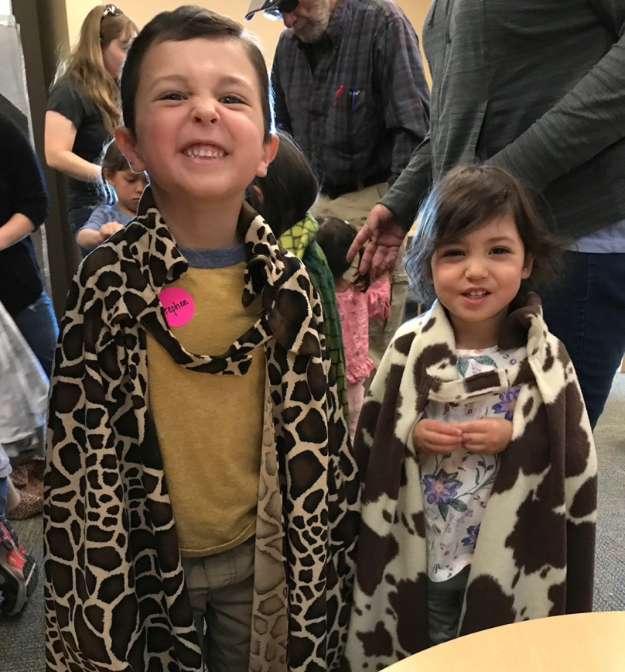
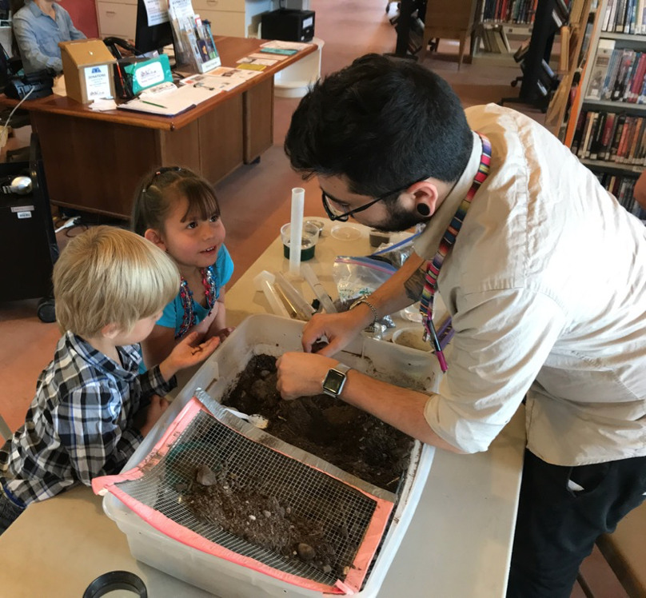
I as a parent, I have enjoyed the opportunity for my child to extend his knowledge of things in the world. My child has enjoyed the experience that is hands on.
I discovered that I can do small but fun science related things with my kids.
Exploring science with an atypically developing child is similar to exploring with a typically developing child - Just need patience!
Notes:
Including the family with the child is an important aspect of many of the programs that are facilitated by Explora either at our location or at locations in the community. These parent/guardian statements are from a program that focused on building opportunities for STEM learning in children aged 0-5 years and their families. Digging in the dirt, wearing a cape to see where you can camouflage and hide were just some of the topics explored by these young children and their adults. As you can see by their reflections that key takeaways was that it does not take special and expensive equipment or certain technical degrees. I especially like the statement that exploring science with an atypically developing child is similar to exploring with a typically developing child - just need patience!

Slide 20
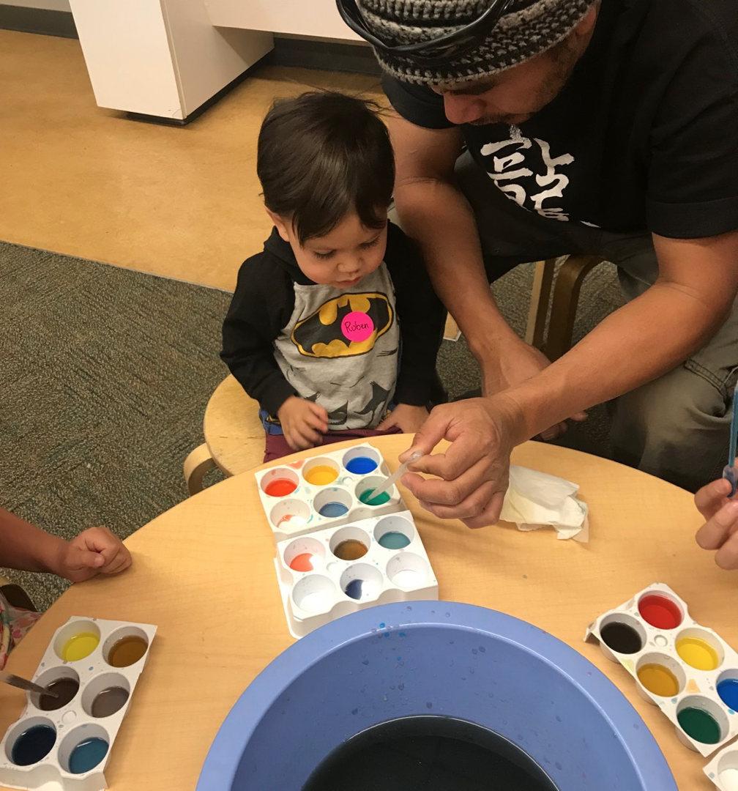
That this class opened my eyes to new ways to allow kids to learn about nature
I discovered my kid will eat brussel sprouts
Thank you for your patience and dedication to science. My family and I learned a lot, I also learned a lot, it brought our families together.
Shaving cream has a lot more uses than I thought.
Notes:
In our programs at Explora we work to integrate novel and known. This often includes using known materials to explore different STEM concepts. For example, the intended use of a material such as shaving cream has so many more applications!

Slide 21
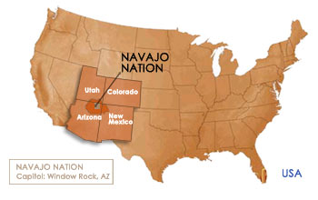
A Few Basic Facts for the Navajo (Diné) Nation
Largest reservation covering over 27,000 miles.
Most homes do not have electricity, running water, or telephones.
~ 50% (180,000) of Navajo tribal members live on or near the Navajo Nation.
32% of households have an income of less than $15,000.
Notes:
A geographical area where Explora has been doing much work is the Navajo (Dine) Nation. Before we share about this work, it is important to understand the context in which that work is taking place. …...

Slide 22
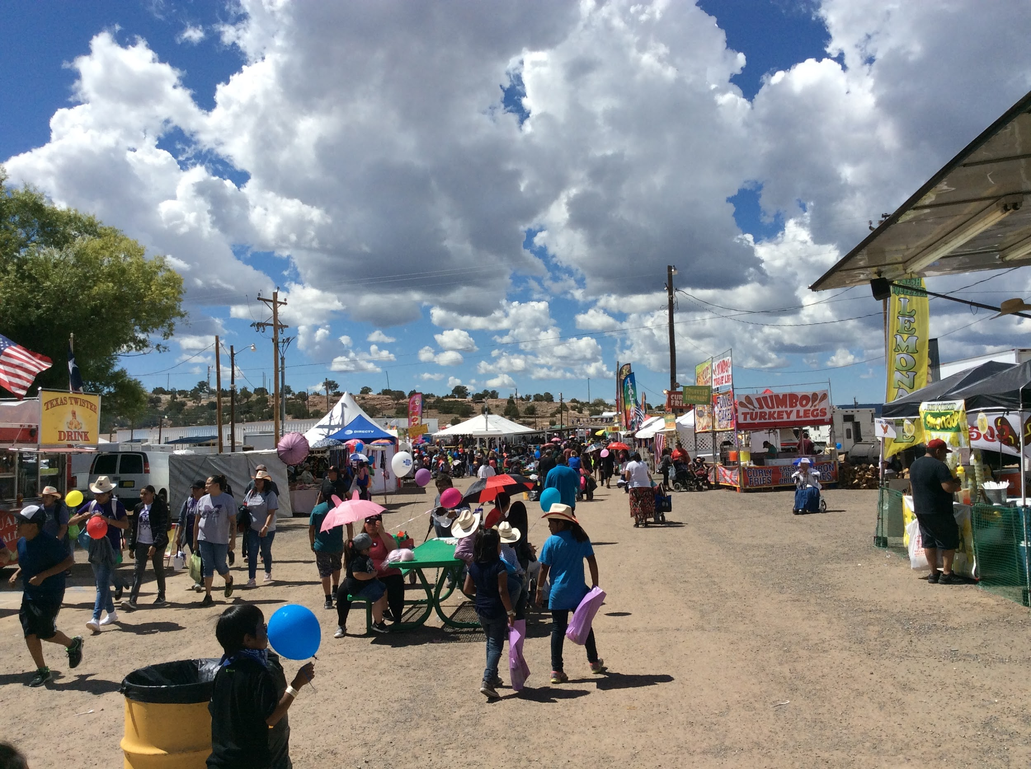
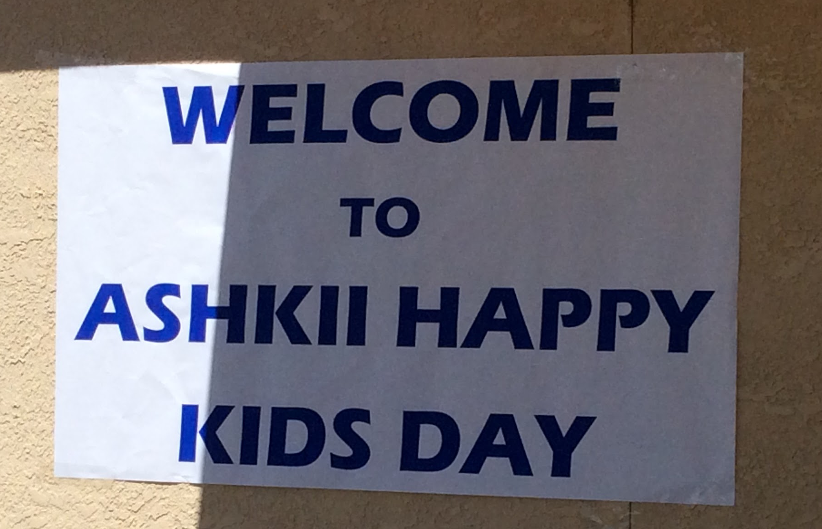
Notes:
In order to build Science Capital there must be opportunities to explore STEM concepts that are made available and accessible to all communities regardless of geographic location. This picture is from …..

Slide 23
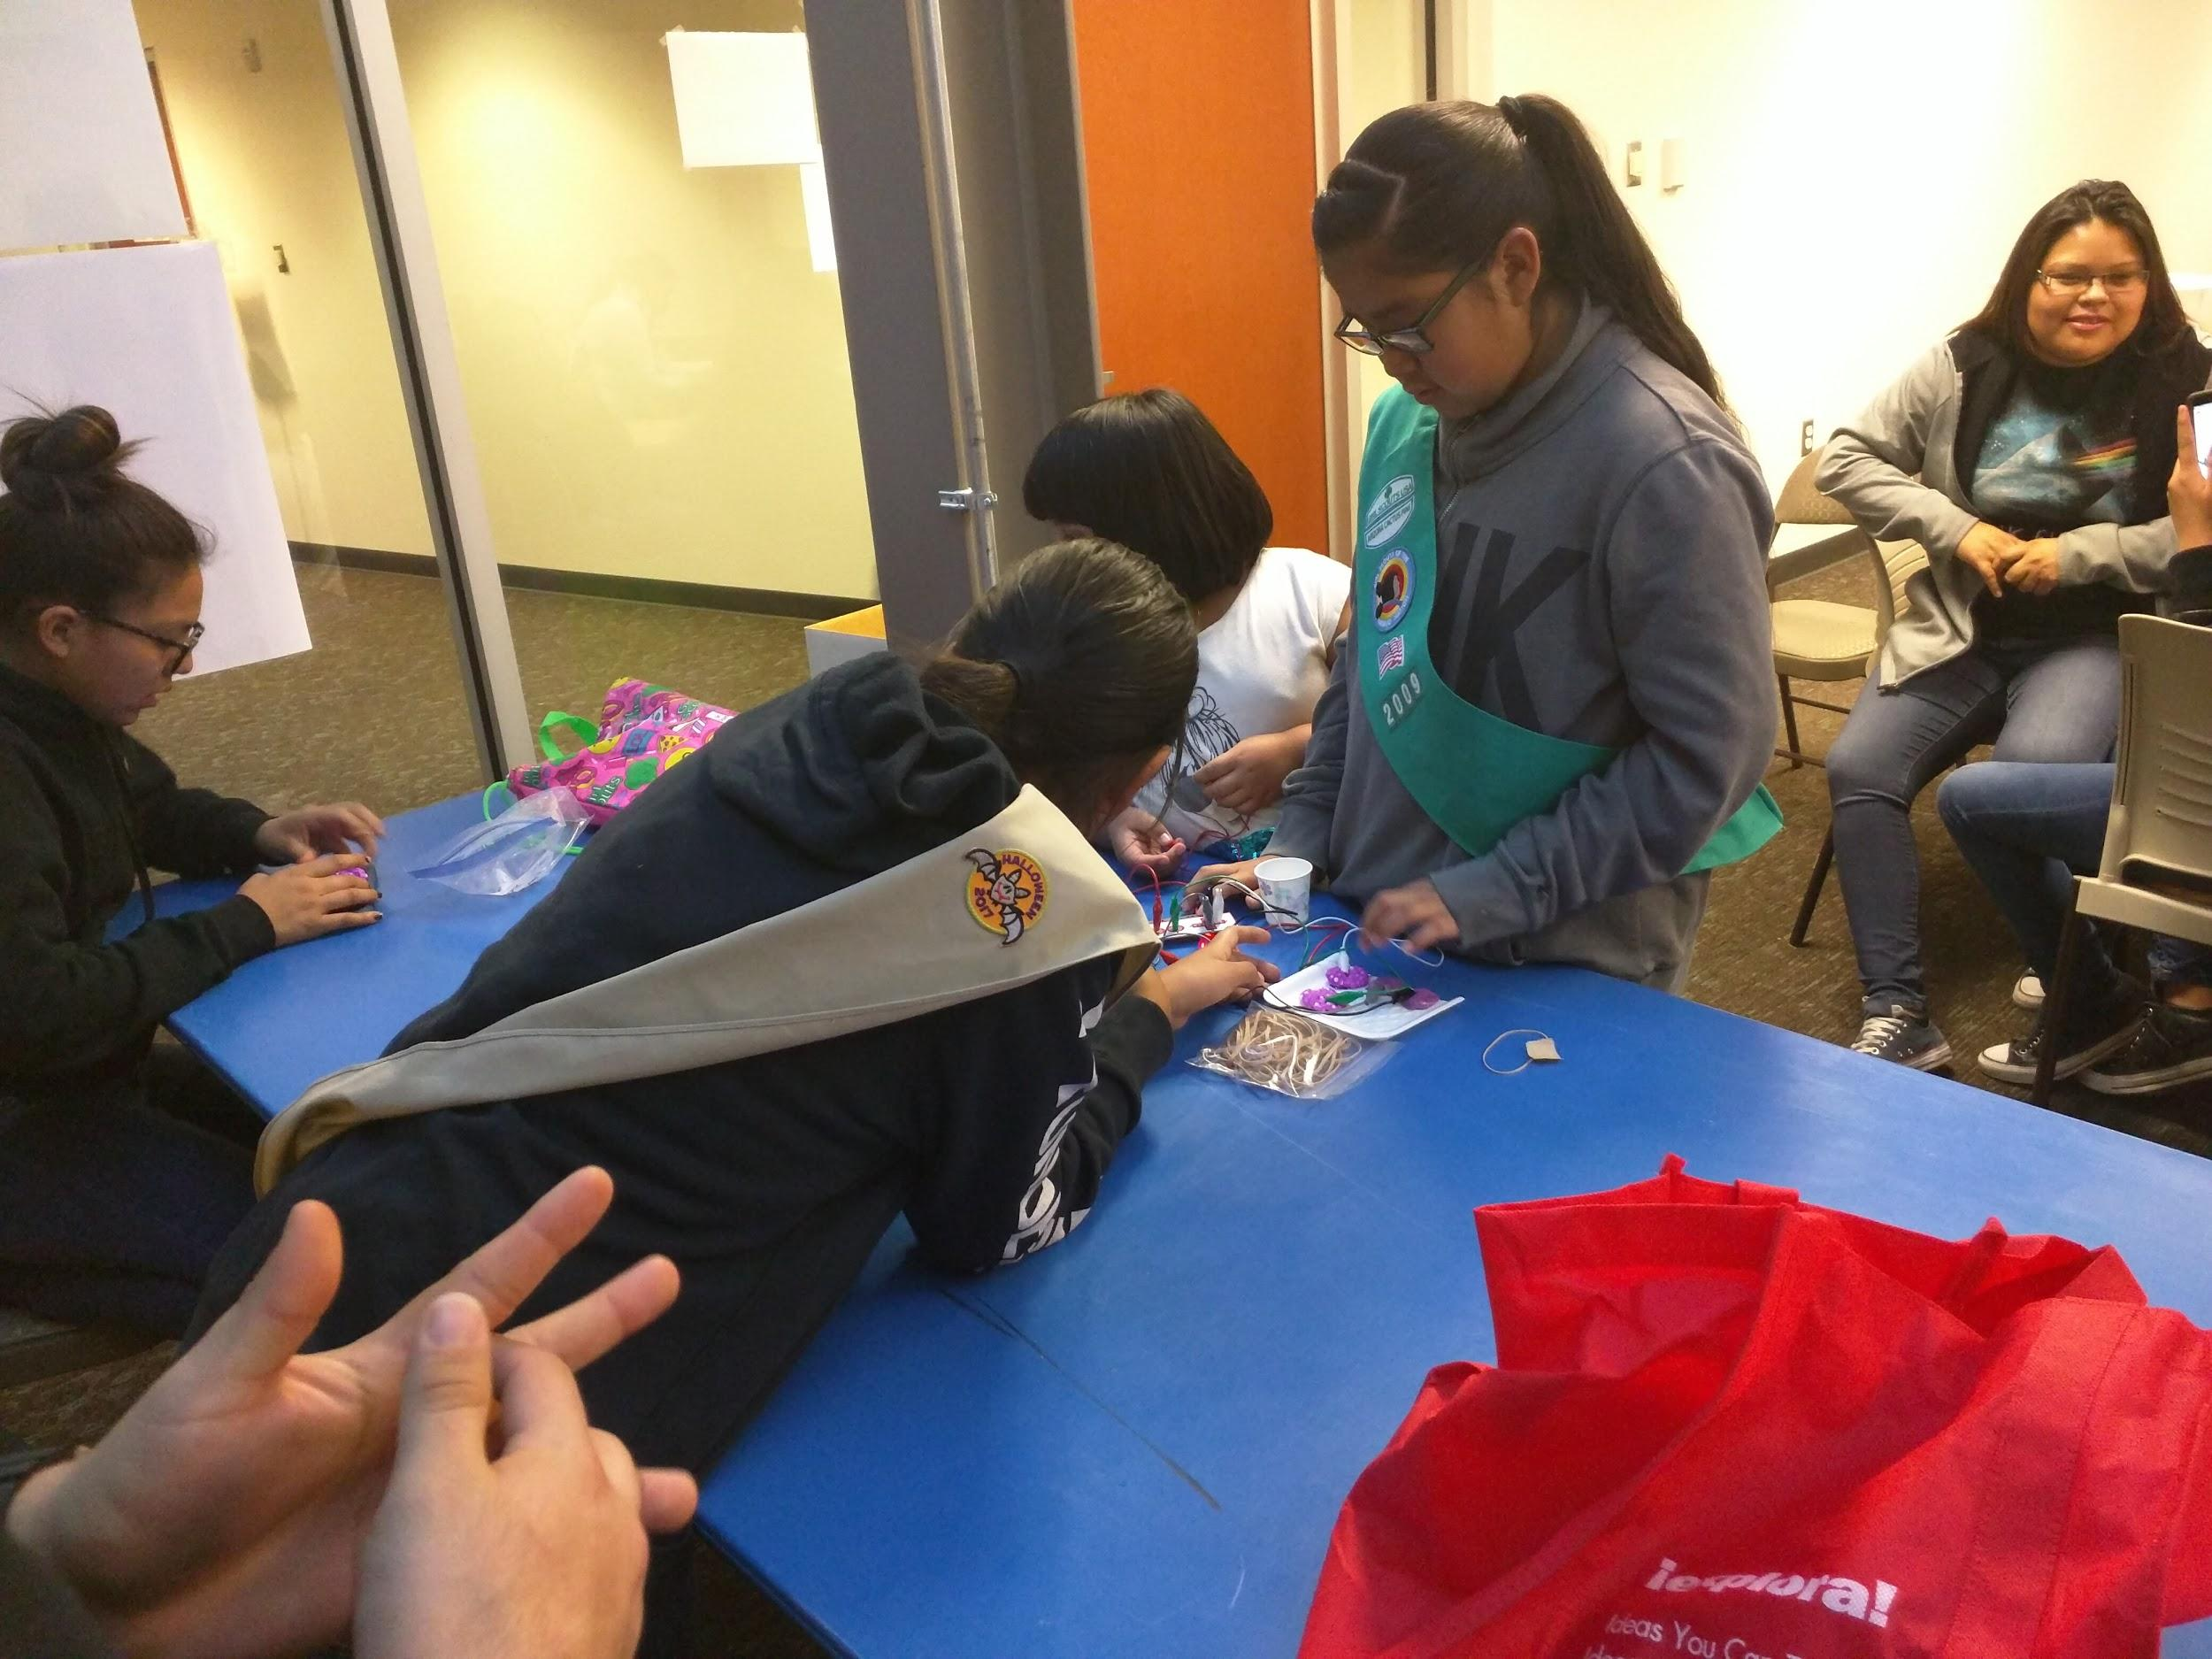
Relationships, Relationships, Relationships
Building relationships - in person conversations are essential.
Lots of driving!!!!!
Notes:
This work has built on relationships and connections. Building relationships = taking the initiative to go the schools in person, going to chapter houses meetings, etc.
Lots of driving - it is pretty common to drive 50 to 200 miles round trip

Slide 24
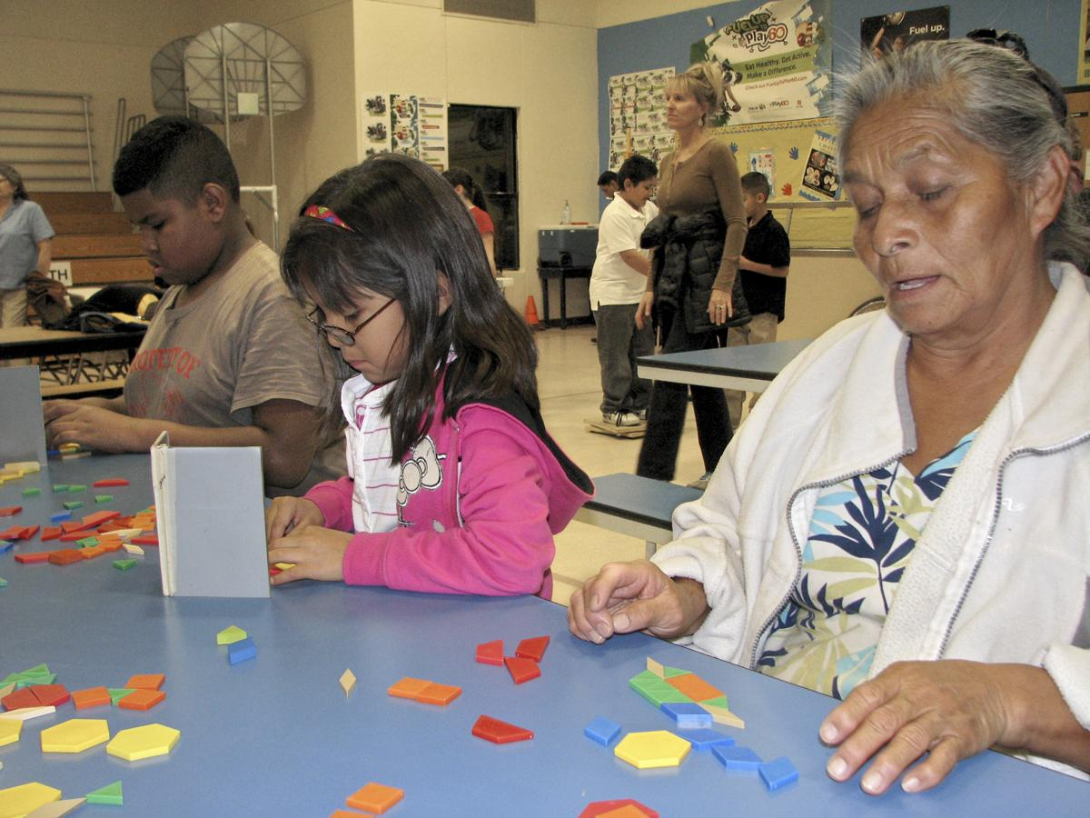
The Explora Family Science nights are an amazing opportunity for inter-generational fun and learning. Explora has provided these opportunities to the remote tribal communities on the Navajo reservation where these experiences are rarely available.
Alana McGrattan, DCA, State Tribal Libraries Coordinator
The students asked if Explora would be coming back to the Navajo Nation Chapters for more education science fairs.
Church Rock Chapter House
Please send Explora our Way again for fall and spring semester of SY18-19 at NO COST to our school since we don't have much funding to expend.
Principal at Naschitti Elementary
Notes:
Taking the time to build the relationships results in requests for more.

Slide 25
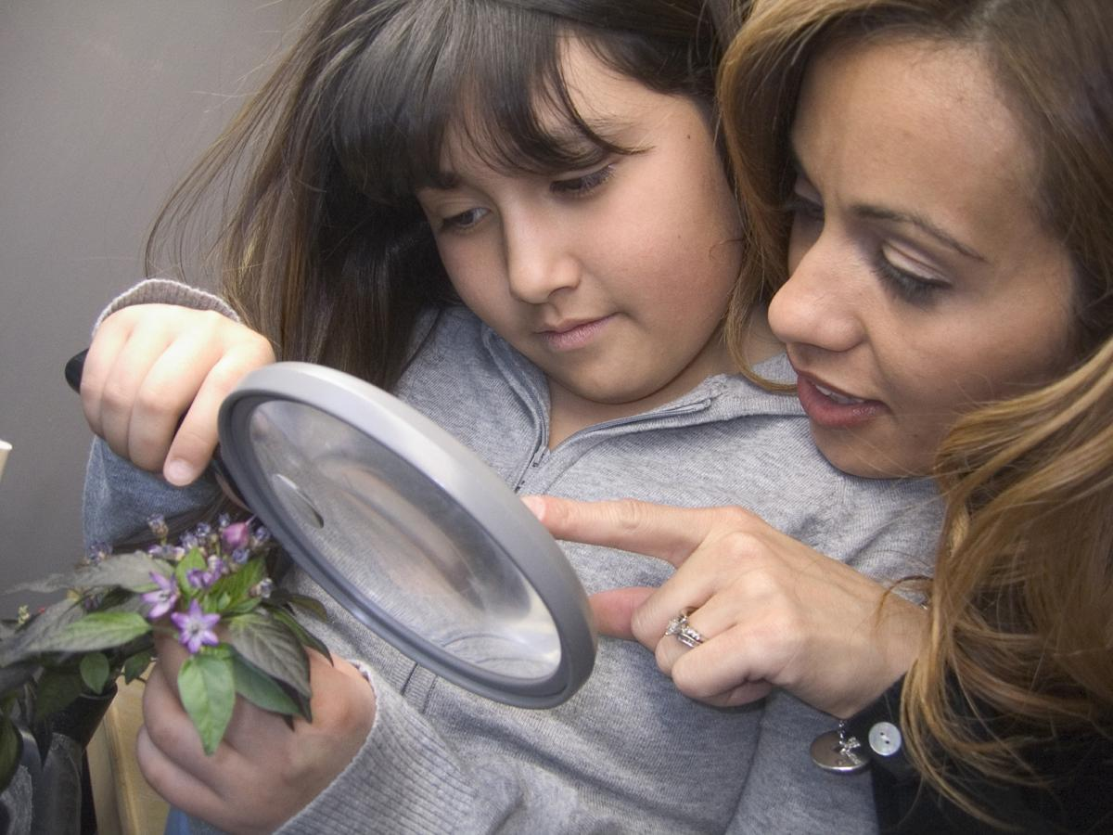
Asset Informed or Trauma Informed?
https://www.brookings.edu/blog/education-plus-development/2019/10/23/from-trauma-informed-to-asset-informed-care-in-early-childhood/
Notes:
To build Science Capital focusing on the Family Habitus, it is important to focus on the assets, skills, talents, and gifts that already exist and build upon those. We’d encourage you to look up this article by Ellen Galinsky that focuses on building on the assets of the family instead of focusing on trauma or deficits as being the destiny.

Slide 26
Building on Community Assets
Asset Based Community Development:
A strategy that builds on the assets that are already found in the community and mobilizes individuals, associations, and institutions to come together to build on their assets-- not concentrate on their needs.
https://resources.depaul.edu/abcd-institute/resources/Documents/WhatisAssetBasedCommunityDevelopment.pdf
Notes:
An approach that has been building our work is that of Asset Based Community Development. This work is part of the ABCD institute that is housed at DePaul University

Slide 27
Guiding Principles of ABCD
Everyone has gifts
Relationships build a community
Citizens at the center
Leaders involve others as active members of the community
People care about something
  Motivation to act
  Listening conversation
  Ask, Ask, Ask
https://resources.depaul.edu/abcd-institute/resources/Documents/WhatisAssetBasedCommunityDevelopment.pdf
Notes:
The guiding principles of ABCD are based on relationships and the idea that people want to contribute. Building from what are the assets in the community is important.

Slide 28
Guiding Principles of ABCD
Asking questions rather than giving answers invites stronger participation
A citizen-centered “inside-out” organization is the key to community engagement
Institutions have reached their limits in problem-solving
  Success = engaging the community in the solutions
Institutions as servants
https://resources.depaul.edu/abcd-institute/resources/Documents/WhatisAssetBasedCommunityDevelopment.pdf
Notes:
The role of organizations and institutions is to listen, ask, include and step back so that the community can lead. At Explora, we have framed our approach as “Listen, Welcome, Co-create”.

Slide 29
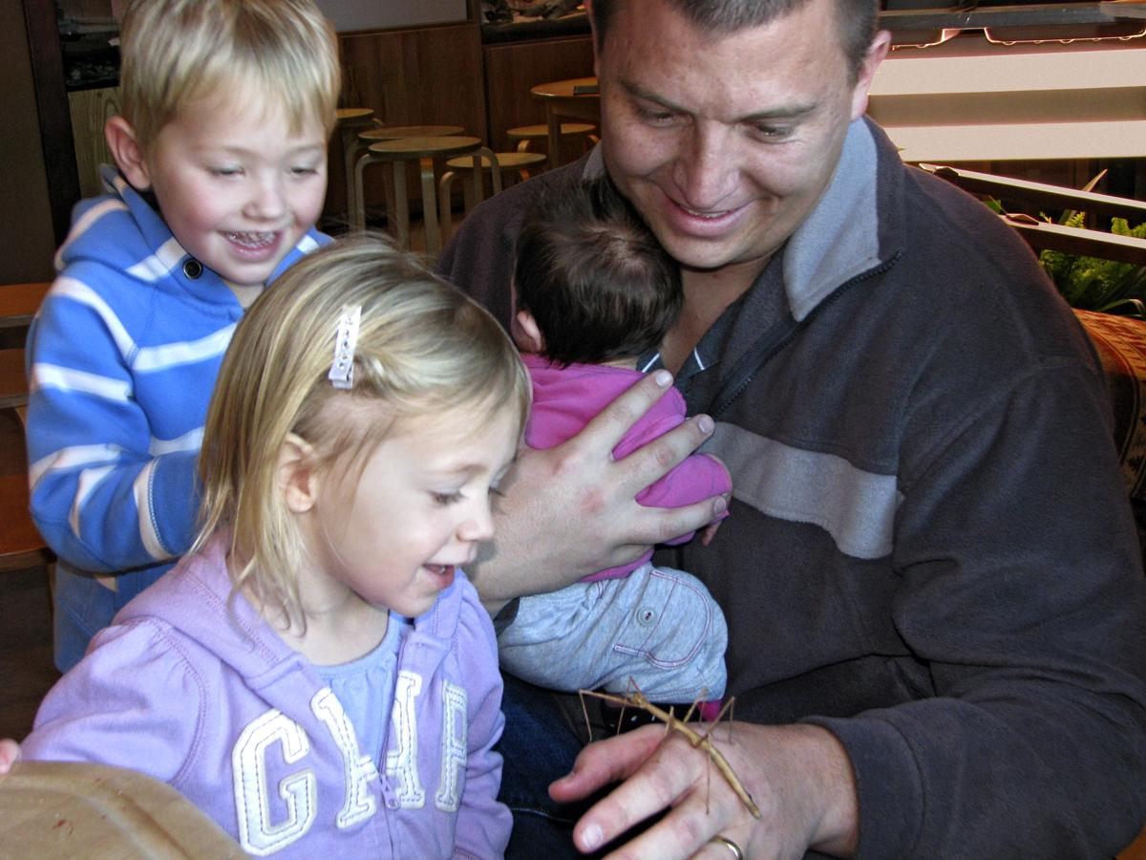
Notes:
To build Science Capital and Family Habitus, the role is larger than that of a single institution or organizations. By building on the assets in the community, by using materials that people are already familiar, by taking the time to develop relationships, we can create opportunities that cultivate young scientist.

Slide 30
Contact Us
Tara Henderson
Director of School and Community Programs
Explora
Albuquerque, NM
thenderson@explora.us
www.explora.us
Victoria Roanhorse
School and Community Programs Manager
Explora
Albuquerque, NM
vroanhorse@explora.us
www.explora.us

