Slide 1


The Science of Play:
A framework for deep, joyful, and developmentally essential learning

Slide 2
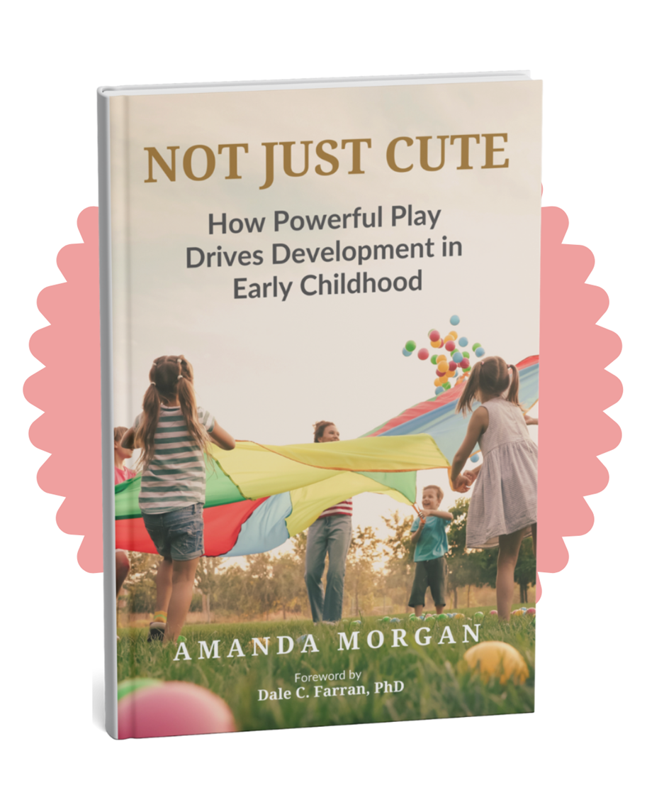

Slide 3
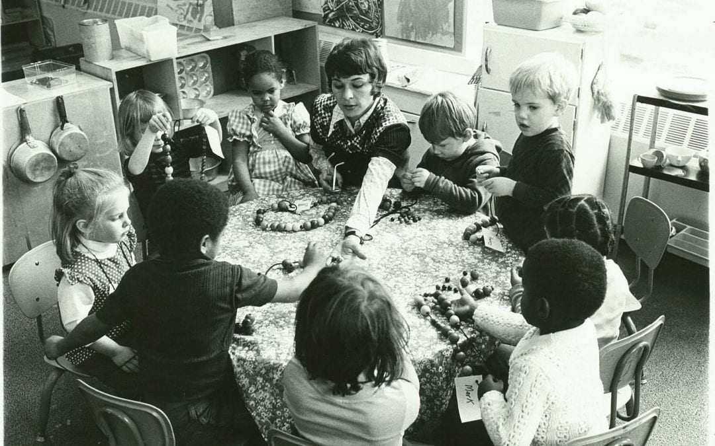
Perry Preschool Project 1962-1967

Slide 4


Slide 5
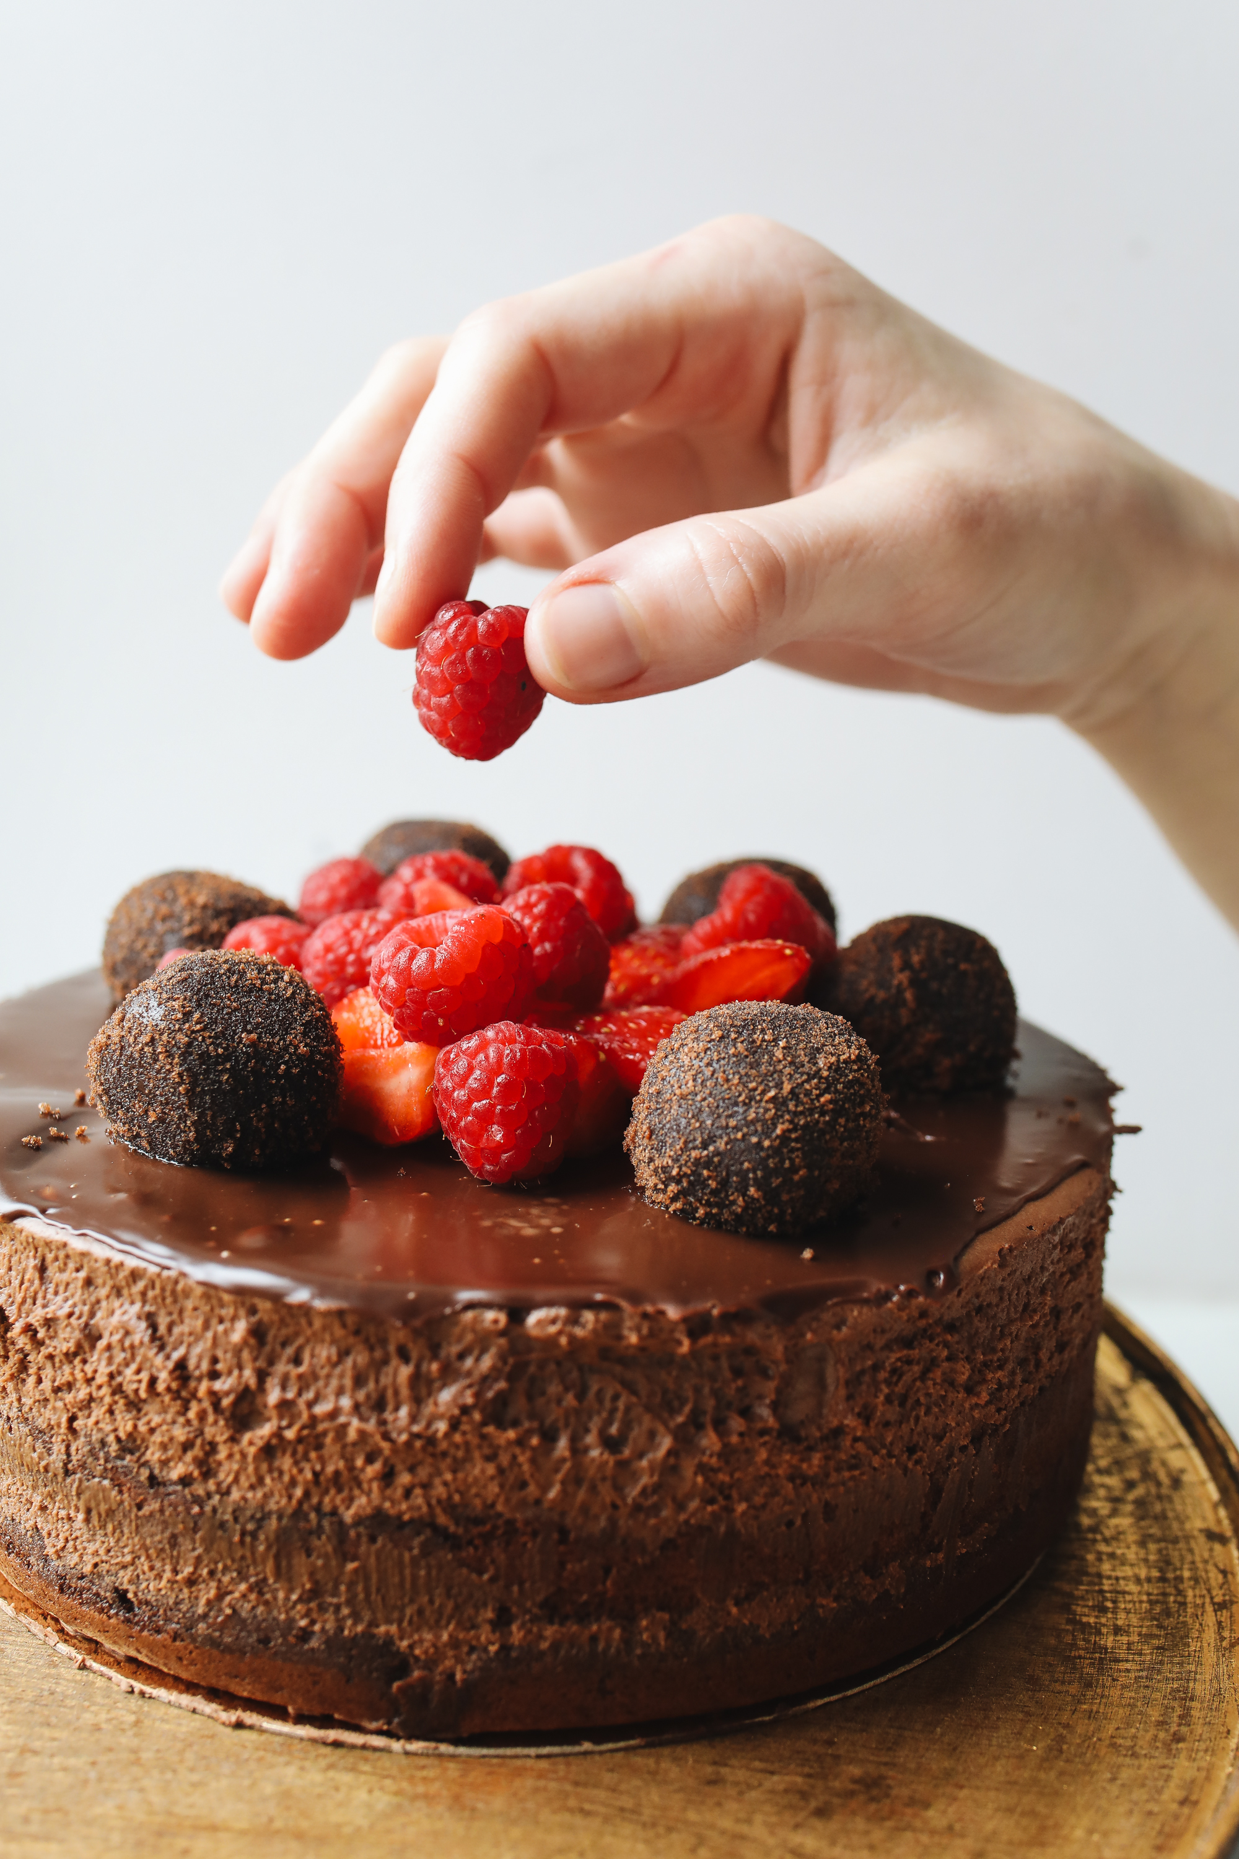

Slide 6

Tennessee Voluntary PreK Program (TNVPK) “Effects of a statewide pre-kindergarten program on children’s achievement and behavior through sixth grade” (Dev. Psychology, 2022)

Slide 7
"It's like saying spinach is really good for you, but we can't afford spinach. But here, I've got this Easter grass. Maybe that will be just as good."
– Dale Farran
Vanderbilt University, Lead Researcher on TNVPK Study
(via “The Tennessee Pre-K Debate: Spinach Vs. Easter Grass.” NPR, 2015)

Slide 8
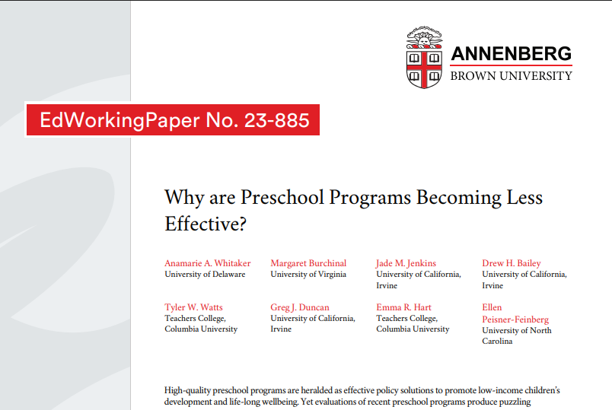
Published: “Why are preschool programs becoming less effective?” (Journal of Policy Analysis and Management, 2026)

Slide 9
Pre 2000 vs Post 2000
Good News:
Bad News:
Published: “Why are preschool programs becoming less effective?” (Journal of Policy Analysis and Management, 2026)

Slide 10
Pre 2000 vs Post 2000
Good News:
Outcomes have improved for all preschoolers.
Bad News:
Published: “Why are preschool programs becoming less effective?” (Journal of Policy Analysis and Management, 2026)

Slide 11
Pre 2000 vs Post 2000
Good News:
Outcomes have improved for all preschoolers.
Bad News:
WHAT and HOW we teach has changed.
Published: “Why are preschool programs becoming less effective?” (Journal of Policy Analysis and Management, 2026)

Slide 12
Pre 2000 vs Post 2000
POLL:
What change do you think has most impacted this outcome?

Slide 13
McCormick, Weiland, Hsueh, Pralica, Weissman, Moffett, Snow, Sachs.
“Is Skill Type the Key to the PreK Fadeout Puzzle?... “
(Child Development, 2021)

Slide 14

Dale C. Farran, PhD
“Early Developmental Competencies or Why PreK Does Not Have Lasting Effects”
(DEY, 2022)

Slide 16
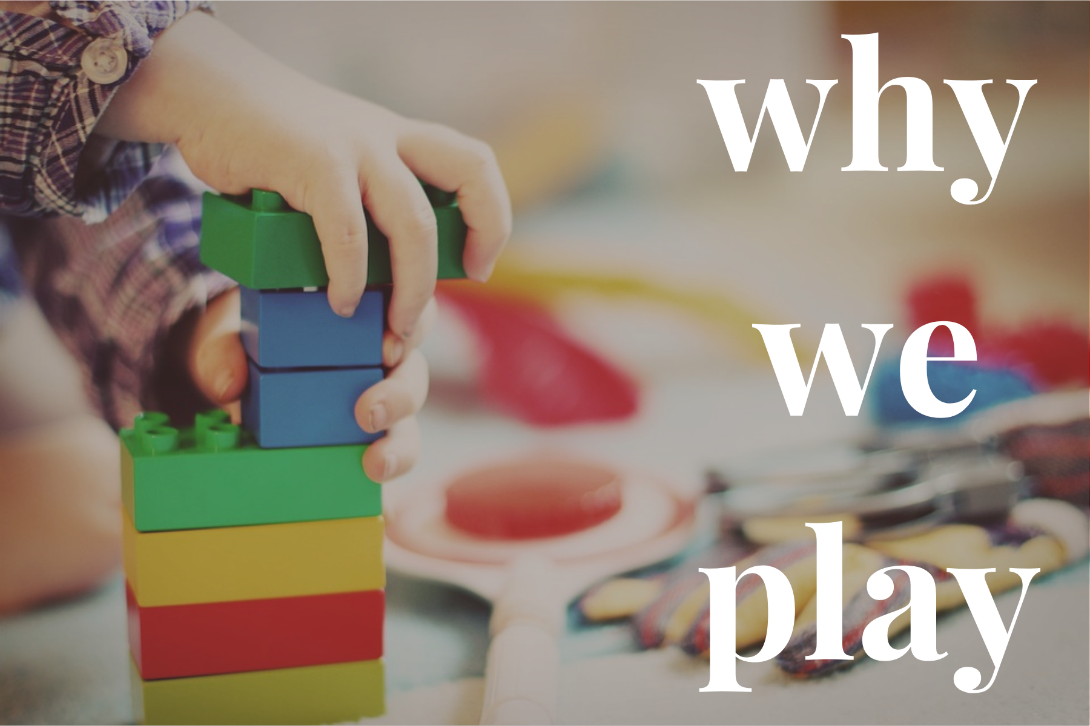

Slide 17
Why We Play
POLL:
What misconceptions do people have about why we play in ECE?

Slide 18

Play is…
…essential for mental health and wellness.
…ideal for promoting learning and brain development.
…full of golden opportunities for soft skill development.

Slide 19
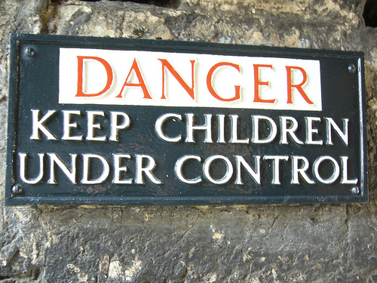
Play is… …essential for mental health and wellness.
Peter Gray
“The Decline of Play and the Rise of Psychopathology in Children and Adolescents”
(American Journal of Play, 2011)
Gray, Peter, et al.
“Decline in independent activity as a cause of decline in children’s mental well-being: Summary of the evidence.”
(The Journal of Pediatrics, Sept. 2023)

Slide 20



Play is… …essential for mental health and wellness.
“Pervasive Passivity”

Slide 21
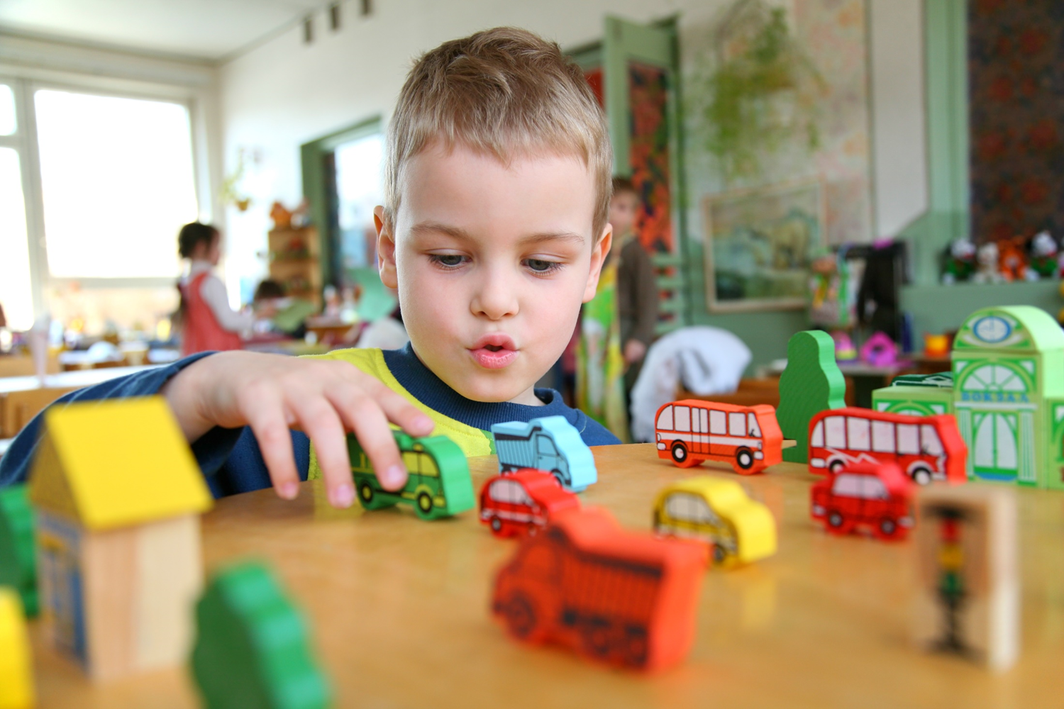
Play is… …essential for mental health and wellness.

Slide 22
PLAY = Joy + Agency

Slide 23
Play is… …ideal for promoting learning and brain development.

Slide 24
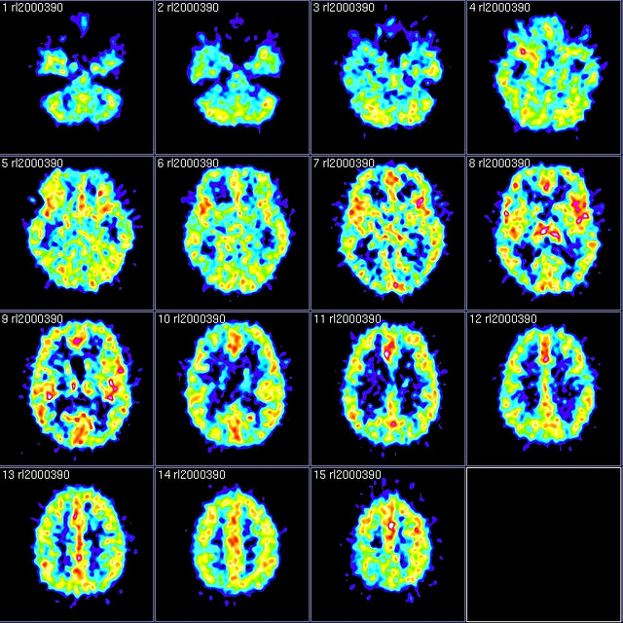
Play is… …ideal for promoting learning and brain development.

Slide 25
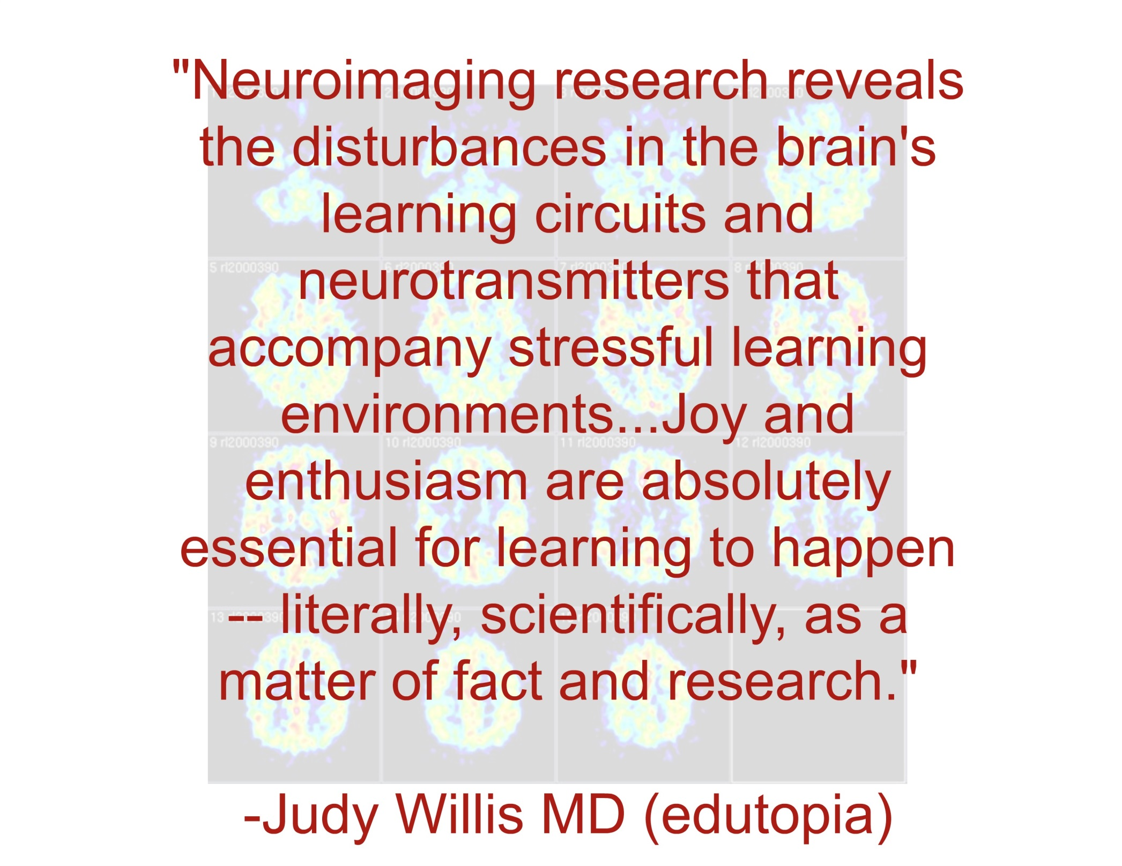

Slide 26
Play is… …ideal for promoting learning and brain development.
“We want RIGOR.”

Slide 27
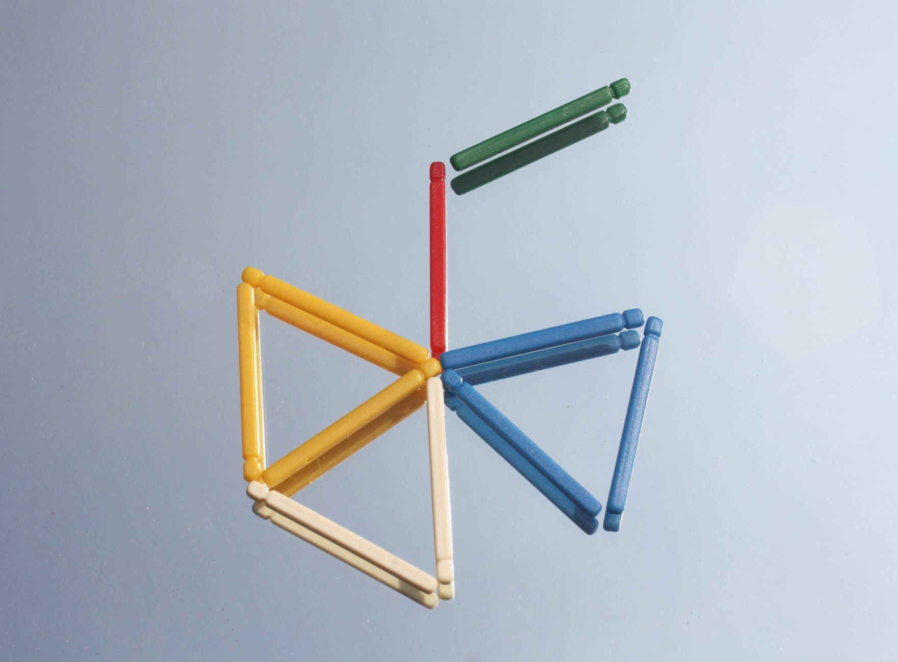
Play is… …ideal for promoting learning and brain development.
Fisher, Hirsh-Pasek, Newcombe, & Golinkoff ”Taking Shape: Supporting Preschoolers' Acquisition of Geometric Knowledge Through Guided Play.”
(Child Development, 2013)

Slide 28
PLAY = Joy + Agency

Slide 29
RIGOR = Joy + Agency

Slide 30
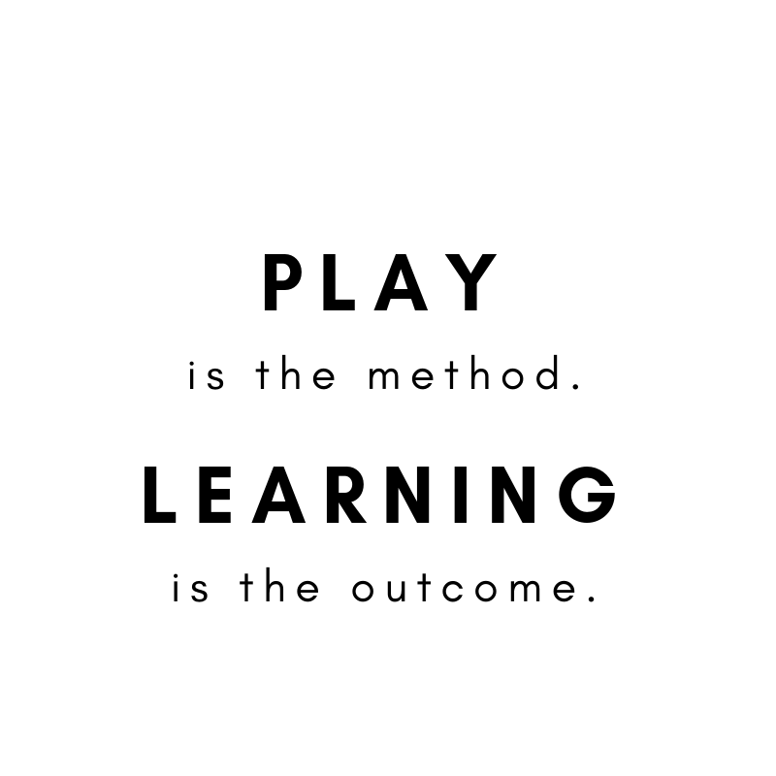

Slide 31
Play is……full of golden opportunities for soft skill development.

Slide 32
McCormick, Weiland, Hsueh, Pralica, Weissman, Moffett, Snow, Sachs.
“Is Skill Type the Key to the PreK Fadeout Puzzle?... “
(Child Development, 2021)

Slide 33
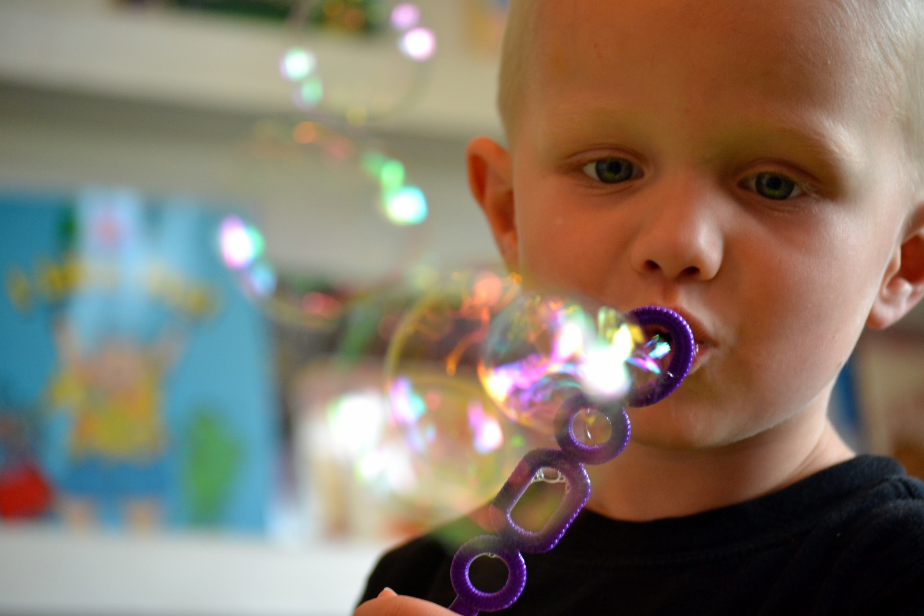
Peer Problem Solving
Understanding People’s Feelings
Shares Materials with Others
Cooperates with Peers
Is Helpful to Others
Listens to Others’ Point of View
Can Share Ideas/Opinions Tactfully
Is Friendly
Soft Skills
Jones, et al, “…The Relationship Between Kindergarten Social Competence and Future Wellness” (American Journal of Public Health, 2015)

Slide 34
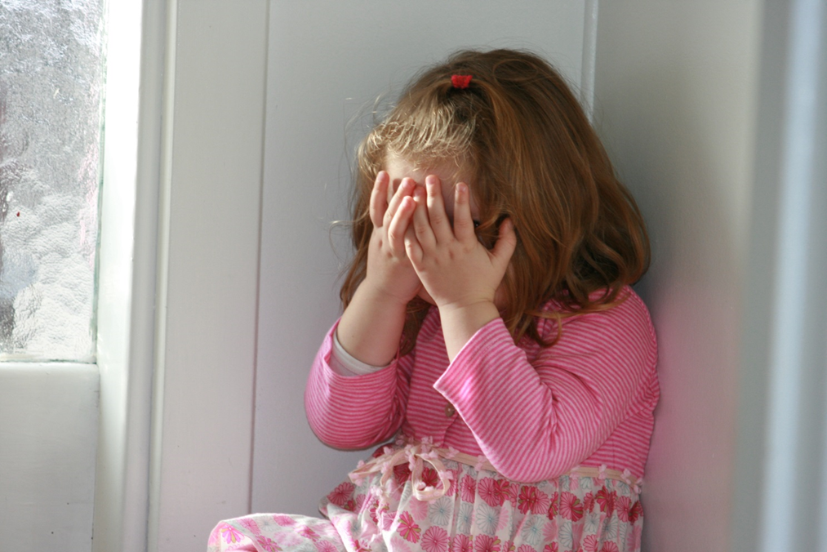
A Tale of Two Studies
Walter Gilliam
“Pre–kindergartners Left Behind: Expulsion Rates in State Prekindergarten Systems” (FCD Policy Brief, 2005)
(NAEYC Presentation, 2009)
Bassok, Latham, Rorem
“Is Kindergarten the New First Grade?” (AERA Open, 2016 )

Slide 35
“It seems that in a developmentally appropriate, play-based approach to early childhood education, children have the opportunity to practice and build soft skills. In inappropriate environments, they’re punished for not already having them.”

Slide 36
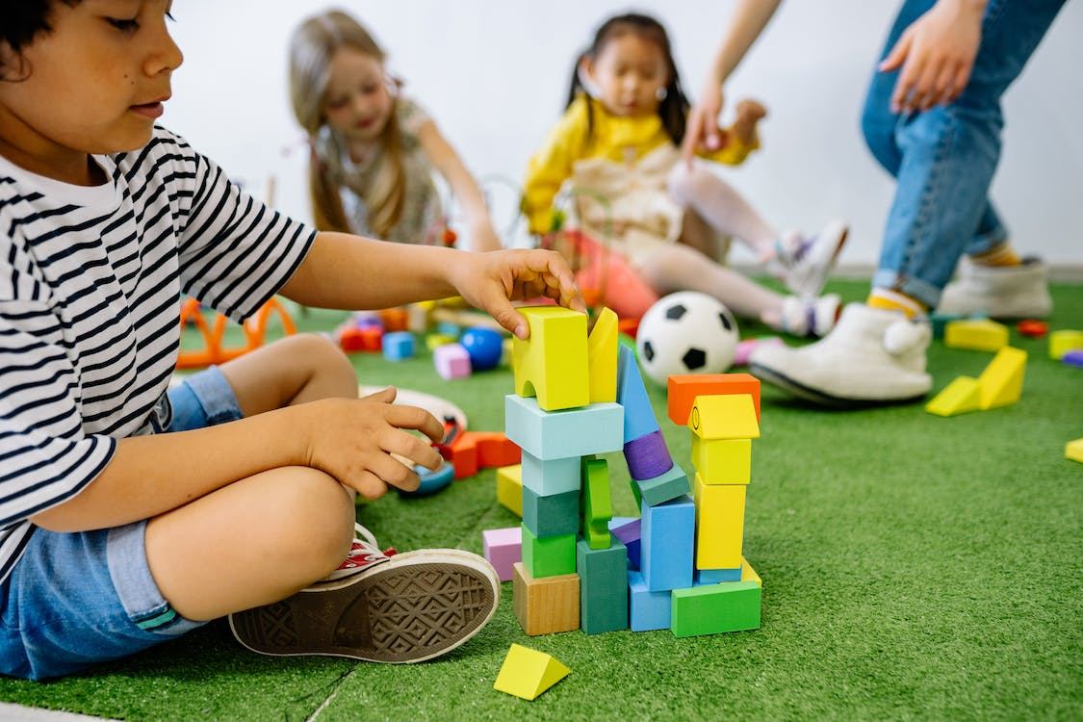
The Long-Term Effects of Universal PreK in Boston
“Sleeper Effect”
No influence on short term measures like standardized test scores in elementary or middle school
More likely to graduate high school, take the SAT, and go to college.
Less likely to be suspended or incarcerated
Gray-Lobe, Pathak, & Walters
The Long-Term Effects of Universal PreK in Boston”
(NBER, Policy Brief, 2021)

Slide 37
PLAY = Joy + Agency

Slide 38
SOFT SKILLS =
Joy + Agency

Slide 39
Play is…
…essential for mental health and wellness.
…ideal for promoting learning and brain development.
…full of golden opportunities for soft skill development.

Slide 40
Why do we need play? Because we’re human.

Slide 41


Slide 42
“(A) crucial factor that sets children apart from AIs is the way that they learn socially, from other people. AIs can learn from very specific and controlled kinds of human supervision. But human children learn from the people around them in much more sophisticated ways.”
Dr. Alison Gopnik, Psychologist, UC Berkley
(via “The Ultimate Learning Machines” Wall Street Journal, 2019)

Slide 43
“Another secret of children’s learning…they are insatiably curious and active experimenters…AIs have mostly been stuck inside their mainframes passively absorbing data… We’re collaborating with computer scientists…who try to make AIs that are similarly curious, active learners.”
Dr. Alison Gopnik, Psychologist, UC Berkley
(via “The Ultimate Learning Machines” Wall Street Journal, 2019)

Slide 44
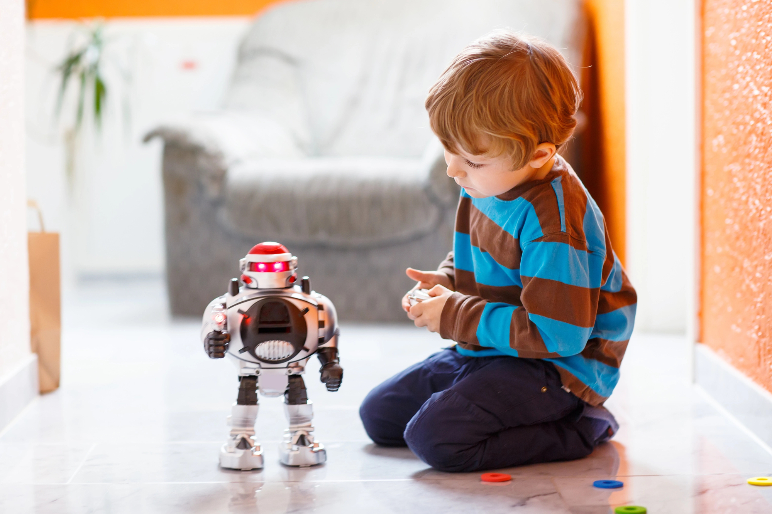

Slide 45
Play is Not Just Cute.

Slide 46
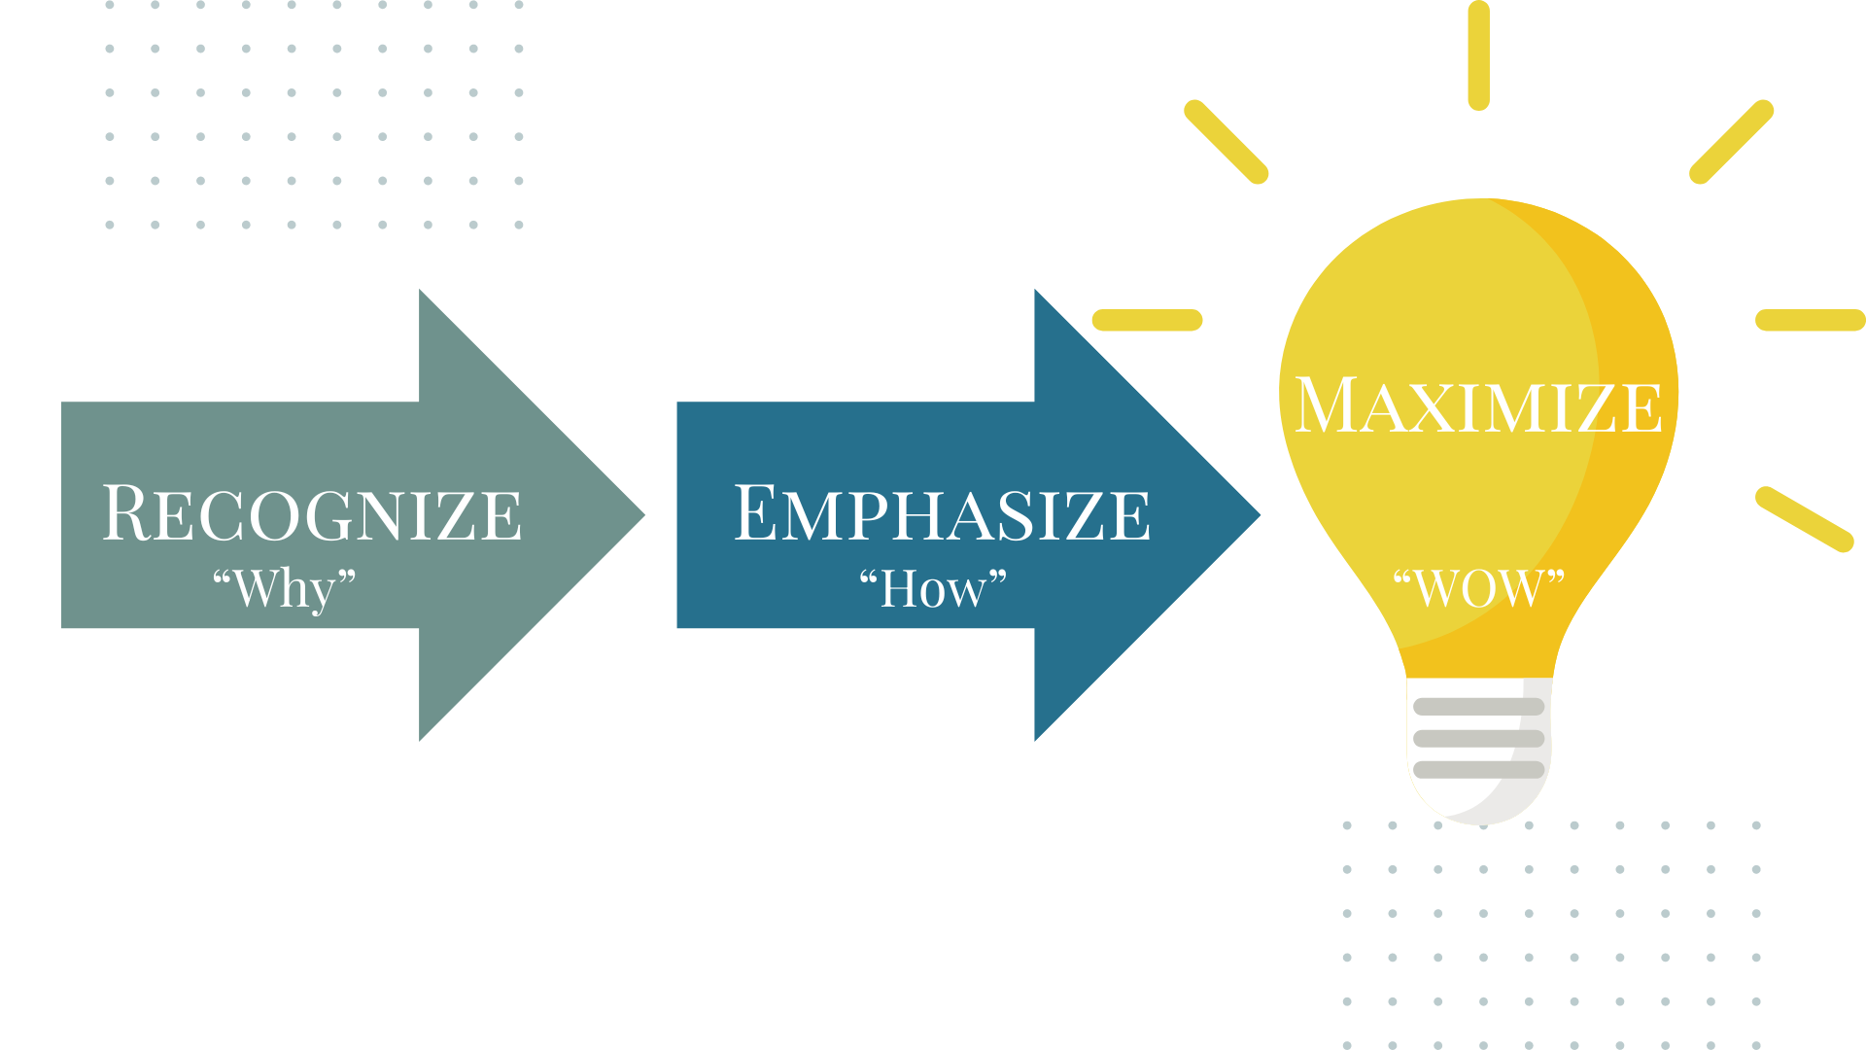

Slide 47
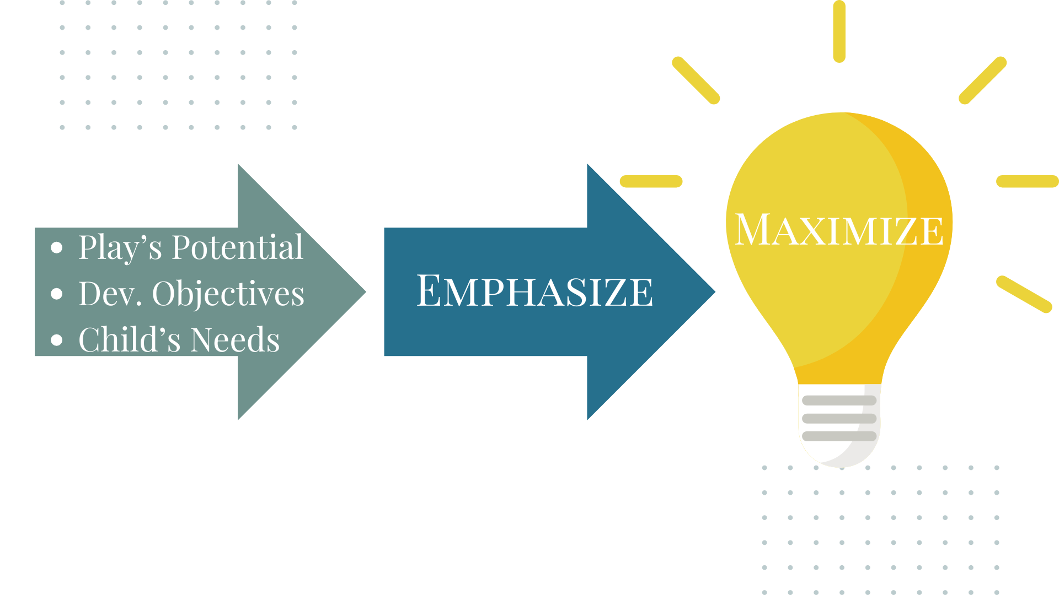

Slide 48


Slide 49

“They knew that what we were doing was good for kids. But they didn’t necessarily have the why, or the research, or the facts to confidently defend it to others, and to advocate for it, and to explain it.
And to take it a little bit deeper.
I feel like my teachers see themselves more as early childhood professionals.”

Slide 51

Take Your Team Deeper into PLAY:
Not Just Cute Book Study
notjustcute.com/book

Slide 52


Take Your Team Deeper into PLAY:
notjustcute.com/powerful play

Slide 53


Take Your Team Deeper into PLAY:
notjustcute.com/speaking

Slide 54
